Slide 1
HELLENIC CENTRE FOR MARINE RESEARCH
Diving routes in the light of marine biology
Argyris Kapantagakis
Institute of Marine Biological Resources, Hellenic Centre for Marine Research

Slide 2
Coastal Alternative Tourism
Marine mammals/birds observations
Fishing tourism
Diving / Snorkeling

Slide 3
Legal framework
Law 4582/2018 – Article 12 (Marine tourism)
Paragraph 5 (Diving tourism)
Law 3409/2005 Diving activities. Introduces the National Leisure Diving Standards which establishes rules to improve diving safety.

Slide 4
The European framework
European coastal and Marine Tourism
Facts
Contributes the 1/3 of the total EU marine revenues
Offers 3,2 mln jobs
Creates 183 bln € in added value
Policy in the Blue Growth framework
Horizon 2020 – Program COSME
Creative Europe
Erasmus +
Life
14 Actions for the communication of the EU Strategy
Source: DG MARE

Slide 5
The target group of diving tourism
Divers
25 mln certified divers world wide - 5mln from EU
1,5 mln active divers making at least one trip per year
Creates 183 bln € in added value
Age group 20-40
High spending power
Snorkelers
Unspecified number. Presumably, all tourists under 60s are considered potentially part of the target group
No studies are available considering the specific character and behaviour of this group
Form a much larger group than the certified divers
Source: World Tourism Organization

Slide 6
The message
Discover the beauty and complexity of the eastern Mediterranean under water life

Slide 7
The diving environment
Environment
Multifaceted morphology
Rich biodiversity
Good visibility
Largely acceptable temperatures

Slide 8
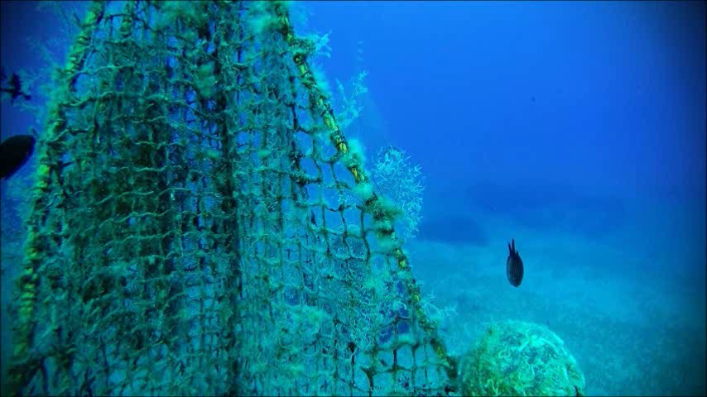
Biodiversity
The hidden asset
Oligotrophic environment
Rich biodiversity
Macrobenthic growth

Slide 9
Were to focus on
Flora
Show the macrobenthic community
Emphasize the human-environment interaction for the benthic communities
Describe the role of macrobenthic communities in maintenance of the overall environmental stability
Fauna
Species life history
Reproduction - Migration - Recruitment
Human environment interaction affecting fish abundance

Slide 10
Were to focus on
Climate change
Show the impact of increase of temperature in the Mediterranean
Show the invasive alien species
Pesca gastronomy
Trophic values
Taste
Local seafood culinary culture

Slide 11
Service provision
Knowledge
Organized (certified) diving centers
Scientific divers
Ichthyologists with diving expertise
Shore support
Organized diving seminars
Knowledge brokerage seminars
Après plongée
Marine biology in practice
Socialization activities

Slide 12
Ευχαριστώ

