Slide 1

A Coastal Zone Survey Project as a Tool for CZM Authorities in Rhodes Island
Dr. D. Vandarakis
G.-A. Hatiris
Hellenic Centre for Marine Research (HCMR)
Hydrobiological Station of Rhodes/HCMR

Slide 2
Coastal Zone (CZ)
The geomorphological area comprising the part of the land affected by marine processes and the part of the sea affected by terrestrial processes.
OR
The geomorphological area bordering the coastline where marine and terrestrial processes, biotic and abiotic factors and human activities interact.

Slide 3
Integrated Coastal Zone Management (ICZM)
It is a resource management system for addressing the complex management issues in the coastal area
Approach: integrative, holistic
Planning process: interactive
Information collection (multi-disciplinary)
Participation & cooperation of stakeholders
Planning
Decision making
Management
Monitoring
Limits
Natural Dynamics
Objectives
Recreational
Social-Economic
Environmental
Cultural

Slide 4
AKTI: Survey in Rhodes Island CZ
Terrestrial and marine geomorphological features (variety & dynamics)
Marine sediments
Marine biodiversity
Marine ecological status
Weather and wave clima
Human interventions
Coastal Vulnerability Index
AKTI: Deliverables
Bathymetric maps (Multibeam echosounding)
Benthic habitats maps
Technical Reports
ICZM suggestions

Slide 5
Coastal Vulnerability Index (CVI) for Erosion - Inundation
Around 41% of Europe’s population is situated near or at the coastal zone (Collet & Engelbert, 2013), plus the visitors-tourists
Coastal environments are most sensitive to changes and pressures but also of great importance for the tourism business
The physical impact of the erosion-inundation due to sea-level rise is one of the most important issues in coastal management
Recent estimations of the future sea-level rise based on climate model output (IPCC, 2013) suggest an increase of the sea level rise of 0,60m until 2100

Slide 6
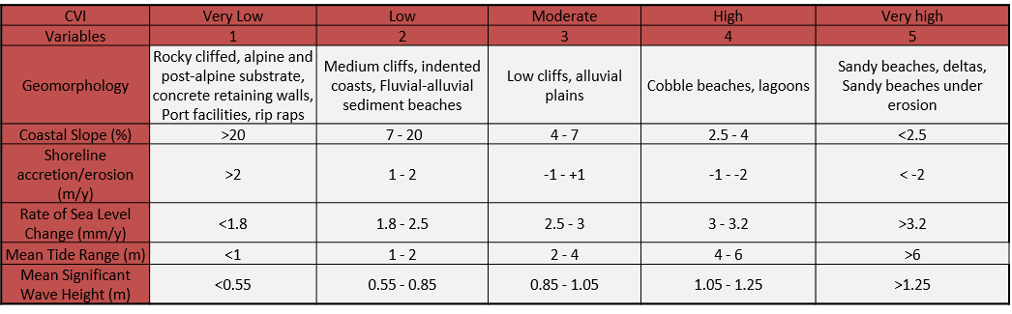
AKTI: Assessment of Coastal Vulnerability Index (CVI) for Erosion – Inundation in Rhodes Island
Data: coastal geomorphology, coastal slope, shoreline accretion-erosion rate, sea level change rate, mean tide, mean significant wave height
Data sources: field work, lab analyses, references, remote sensing, monitoring stations

Slide 7
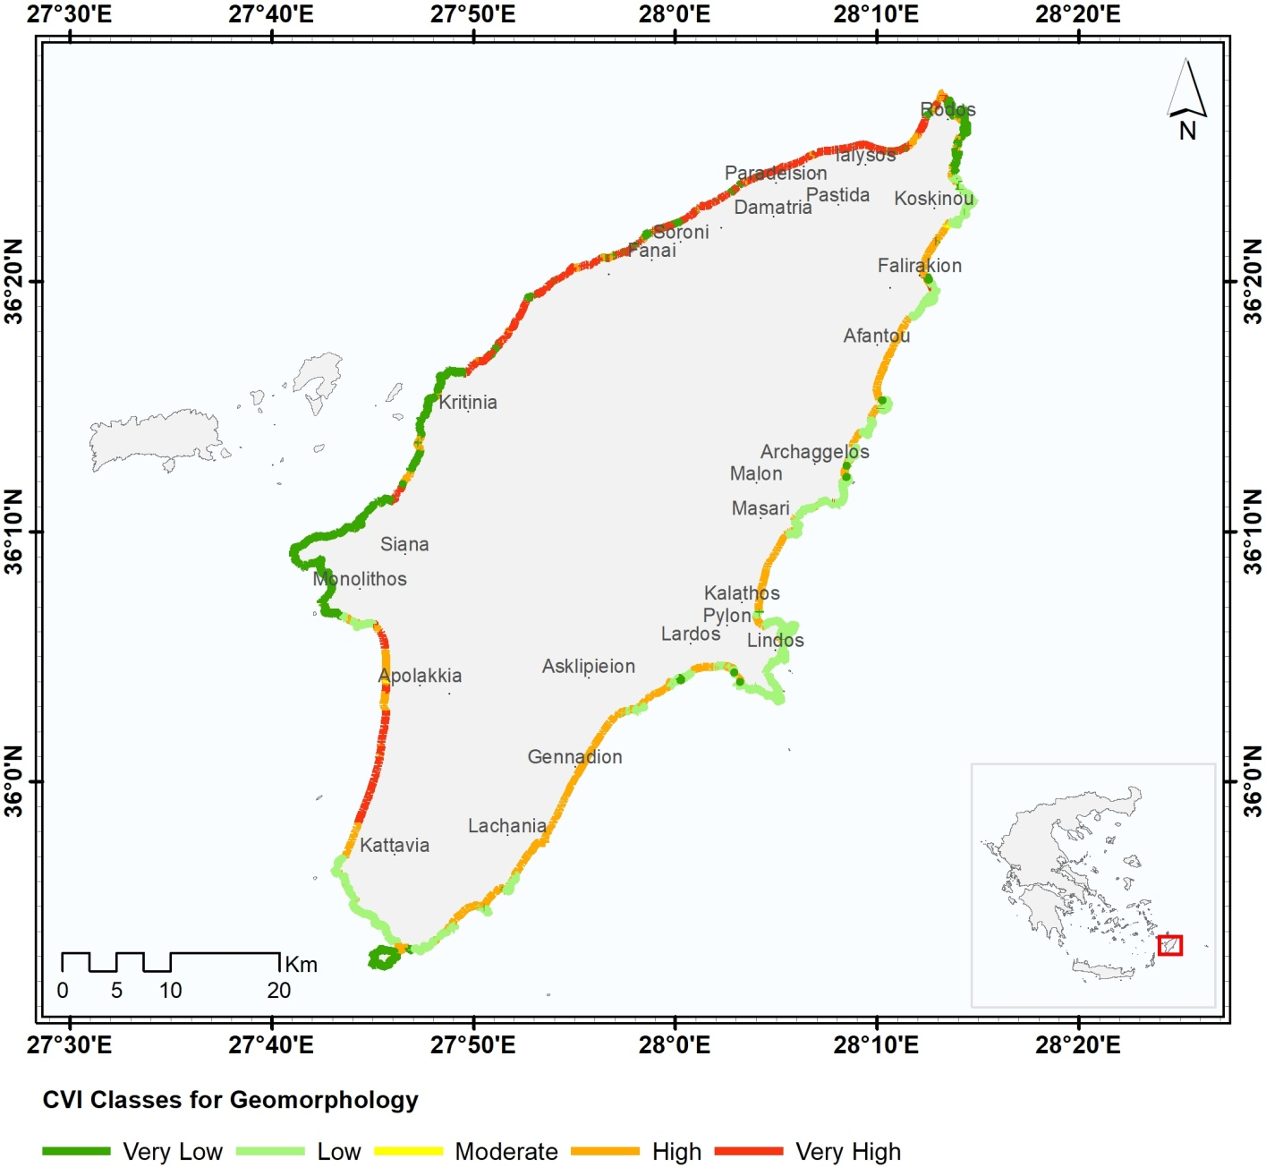
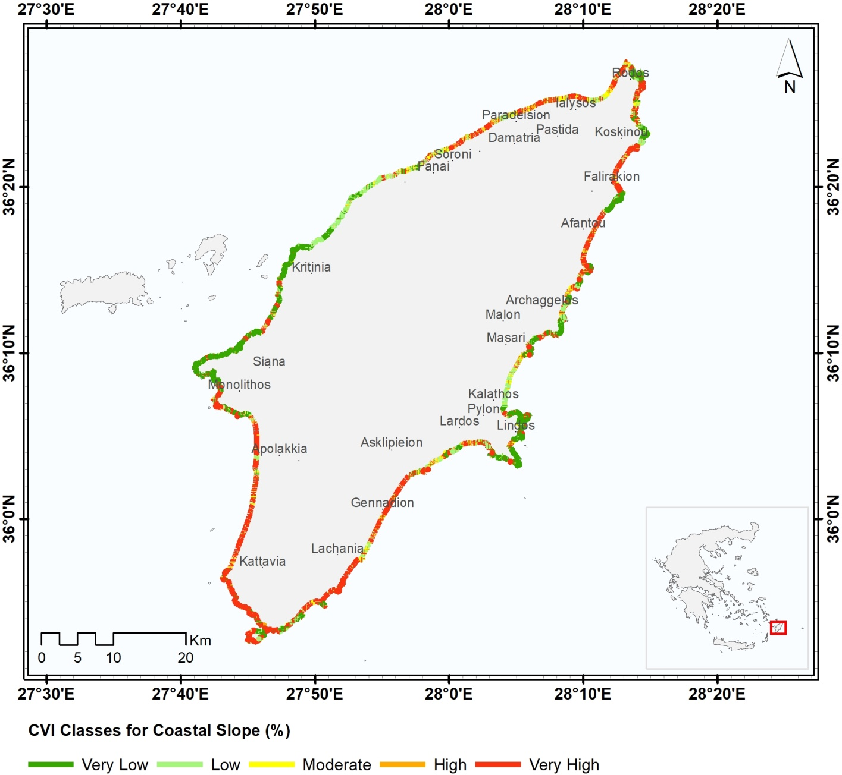
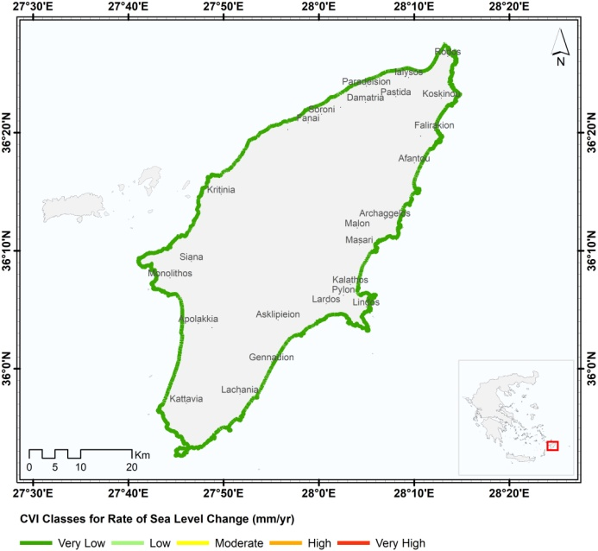
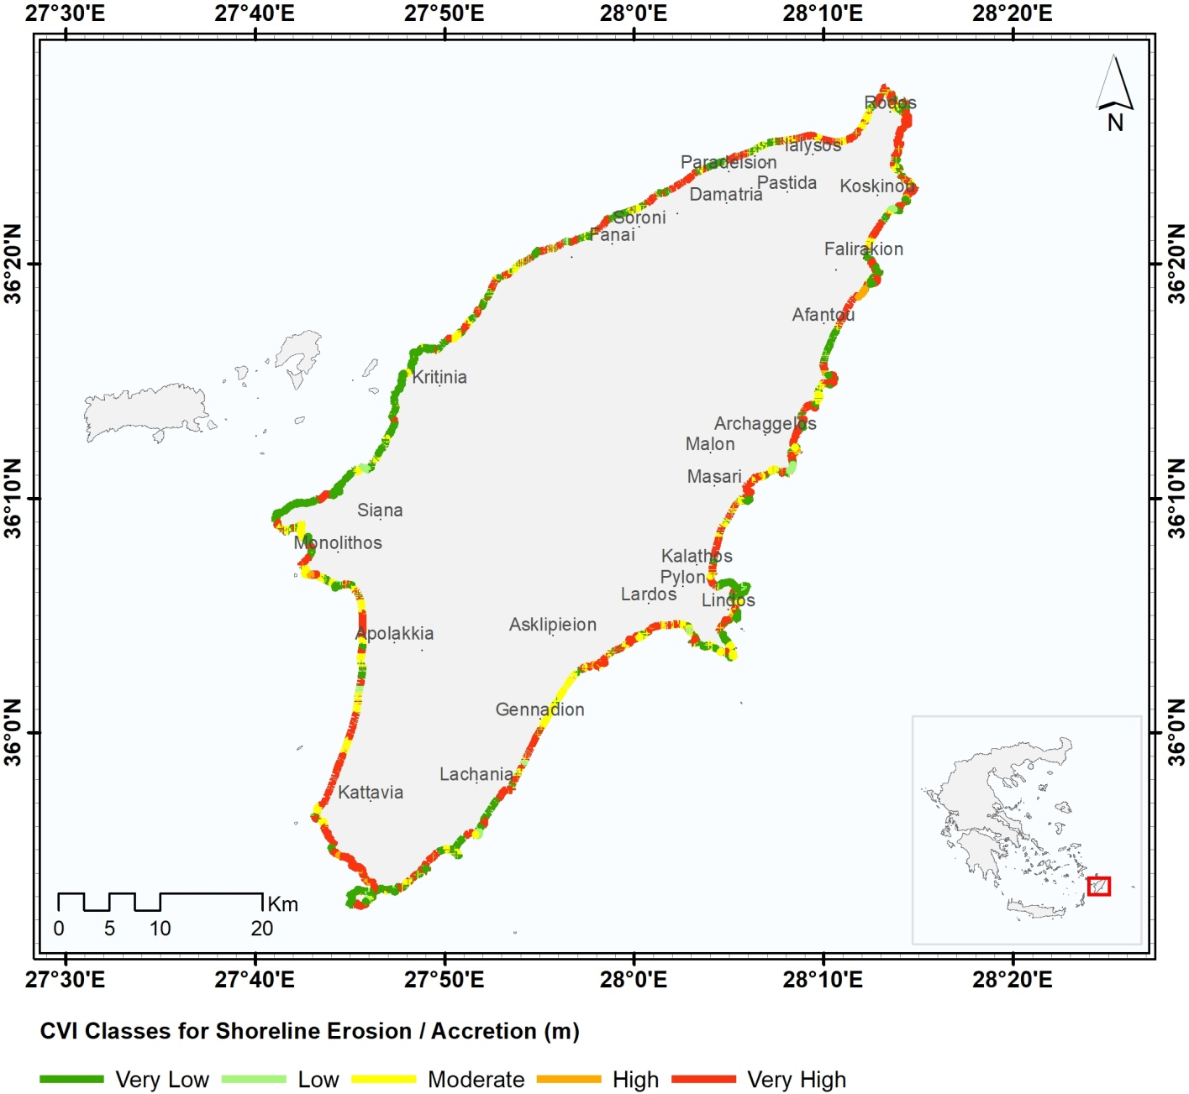
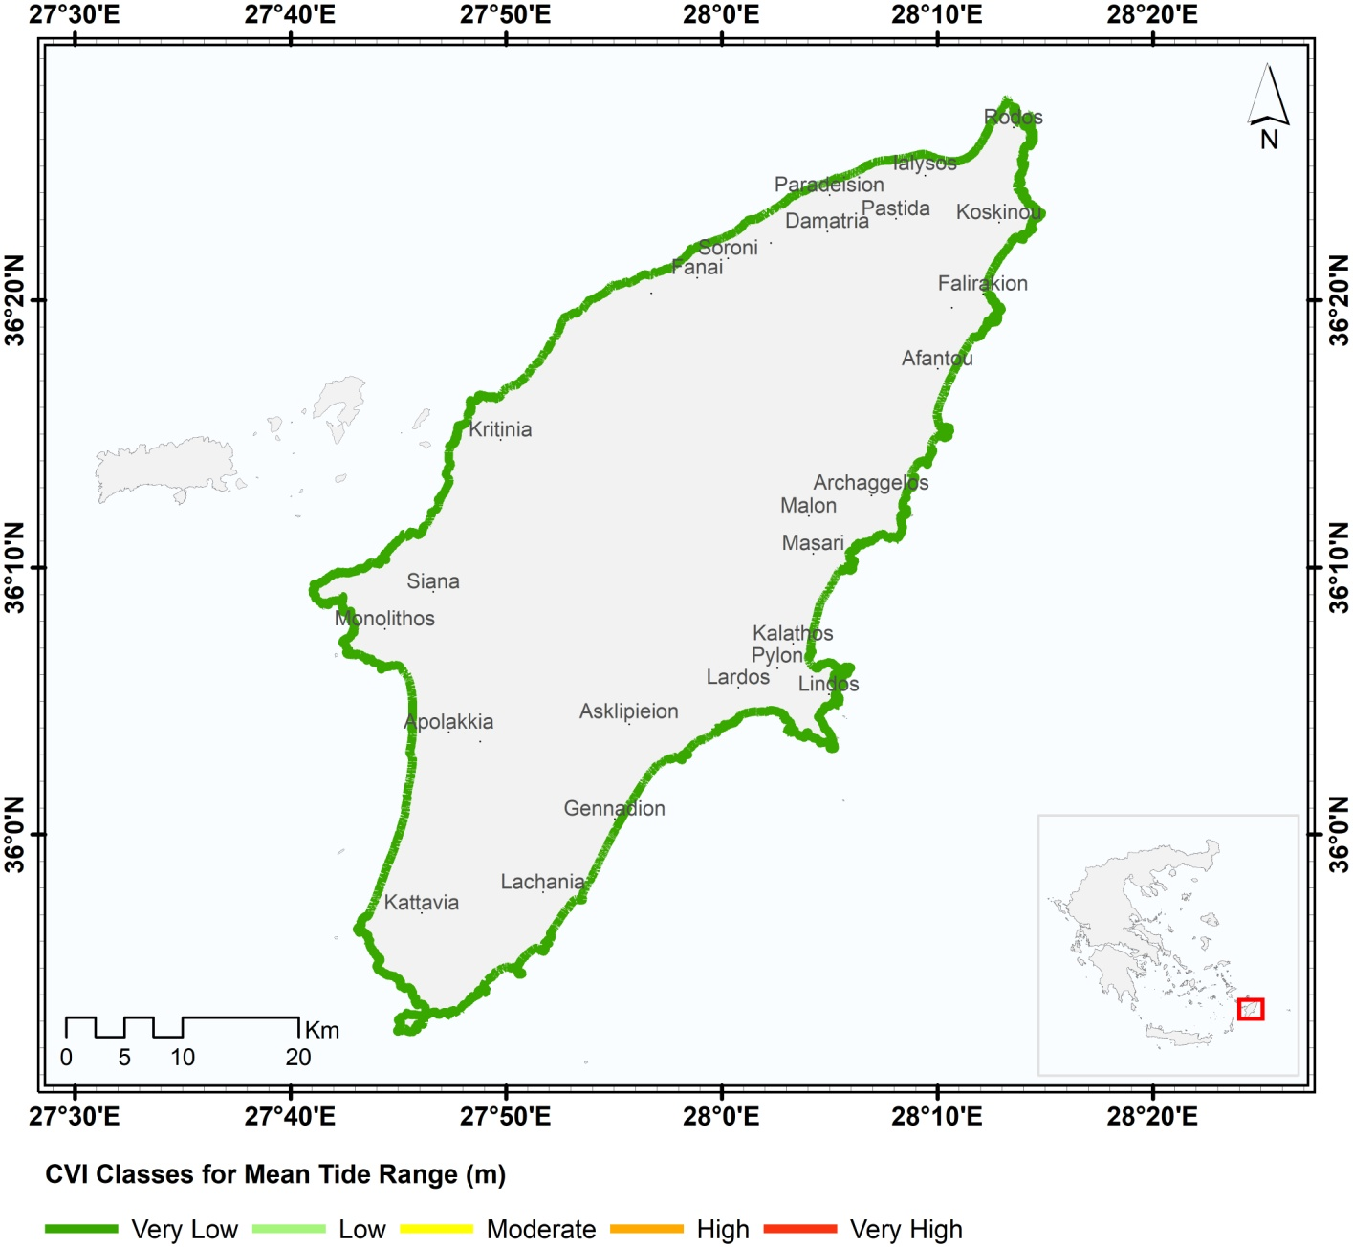
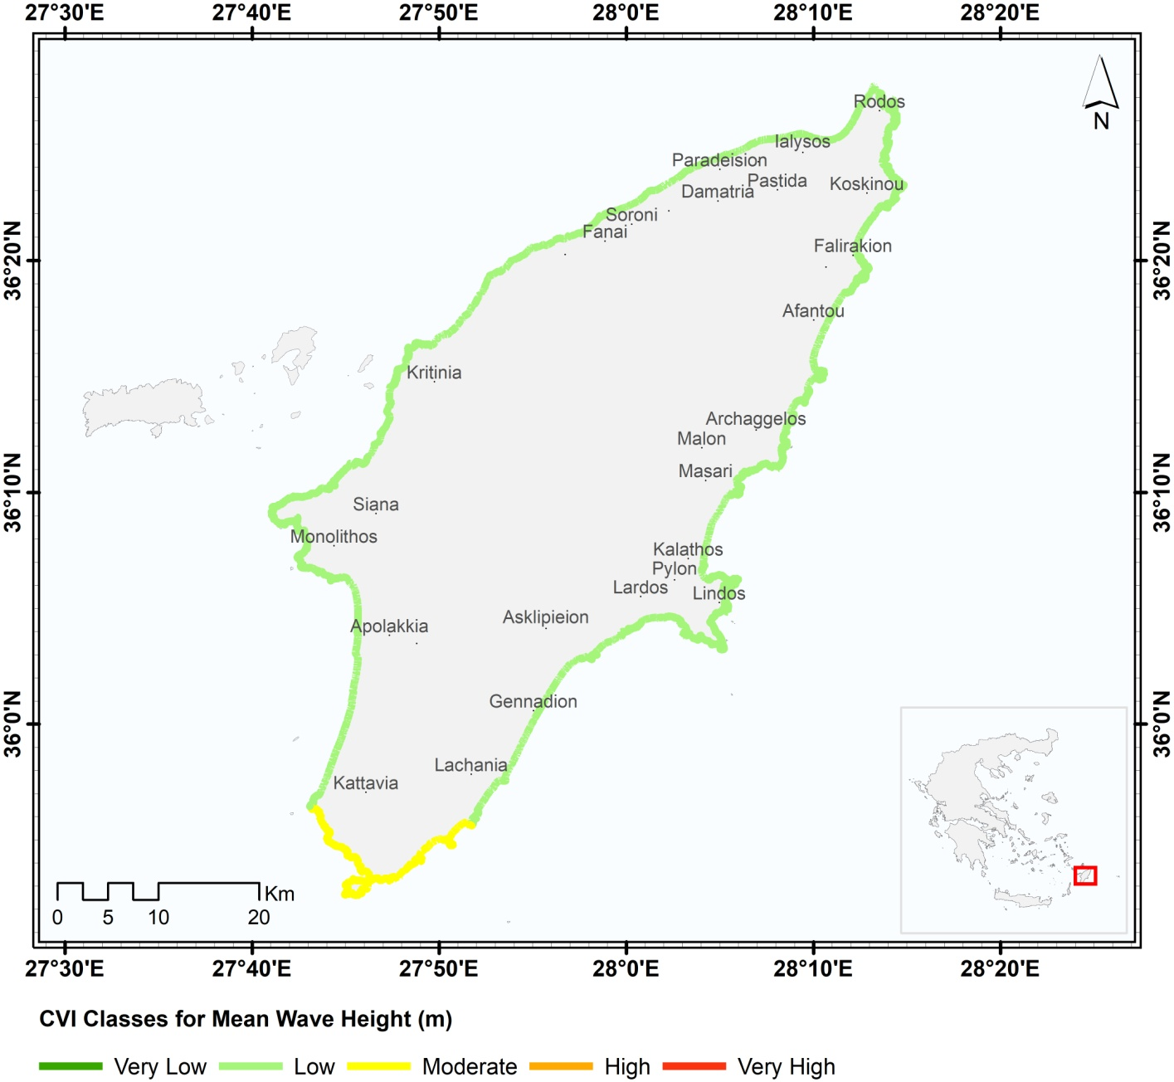
AKTI: CVI Maps for Rhodes Island CZ
Geomorphology CVI
Coastal Slope CVI
SLR CVI
Shoreline Change CVI
Mean Tide Range CVI
Mean Wave Height CVI

Slide 8
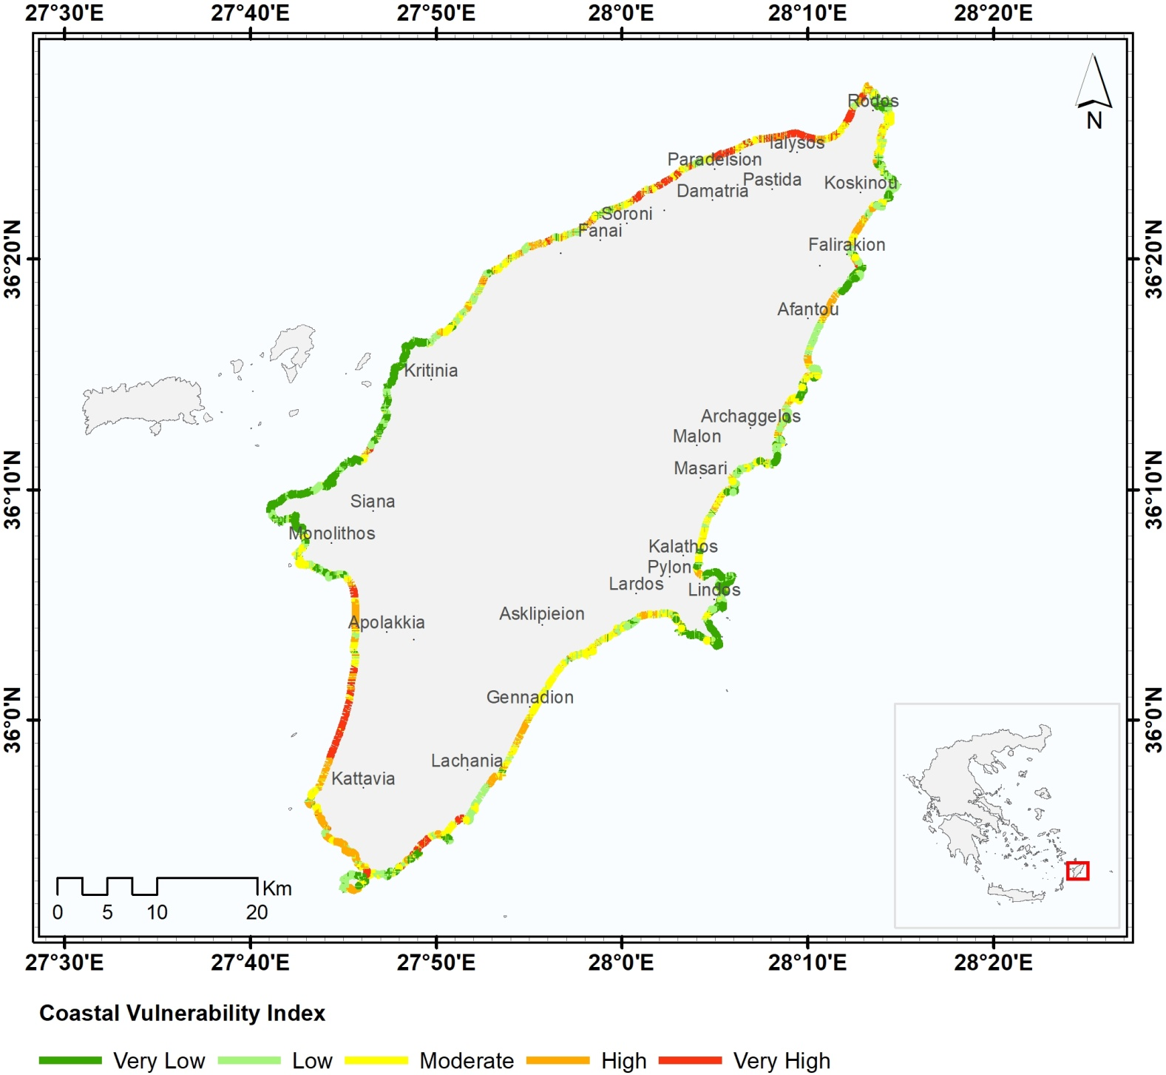
Results-CVI Map for the island of Rhodes
Faliraki, Afantou, Ialysos, the city of Rhodes (vulnerable in parts) and Prasonissi-beach (Southern part) present Moderate to Very High Vulnerability .
The most vulnerable areas are the coastal areas presenting low inclination, unconsolidated sediments, exposed to high wave heights, situated mainly in the NW part, the NE part, the SE part and SW part.

Slide 9
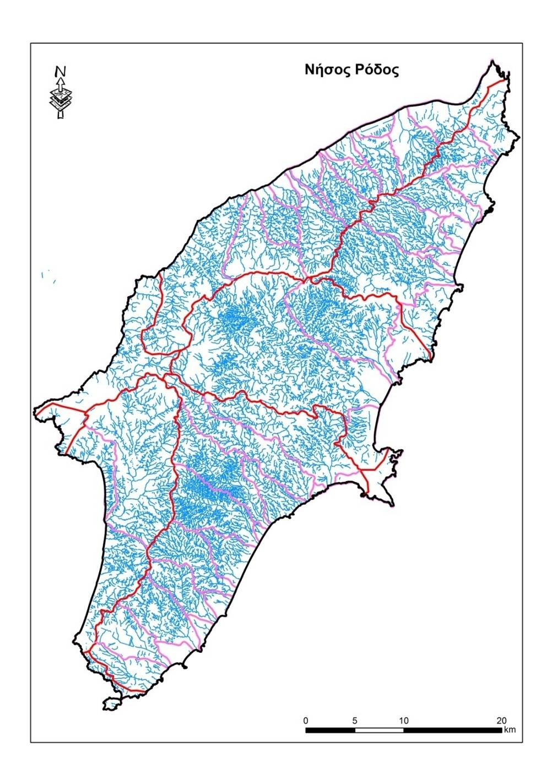
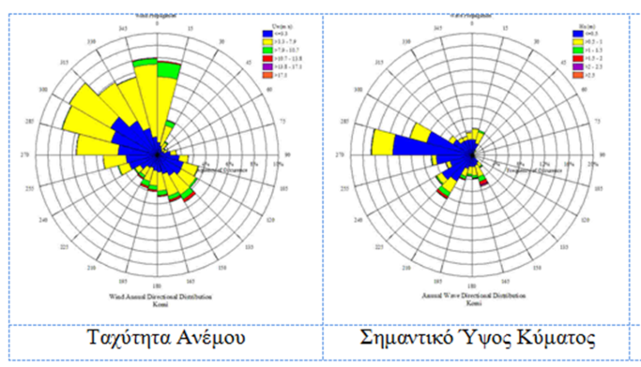
AKTI: Terrestrial and marine CZ of Rhodes Island
Geodynamics
Geology
Geomorphology
Hydrographic networks
Human interventions
Wave and weather clima

Slide 10
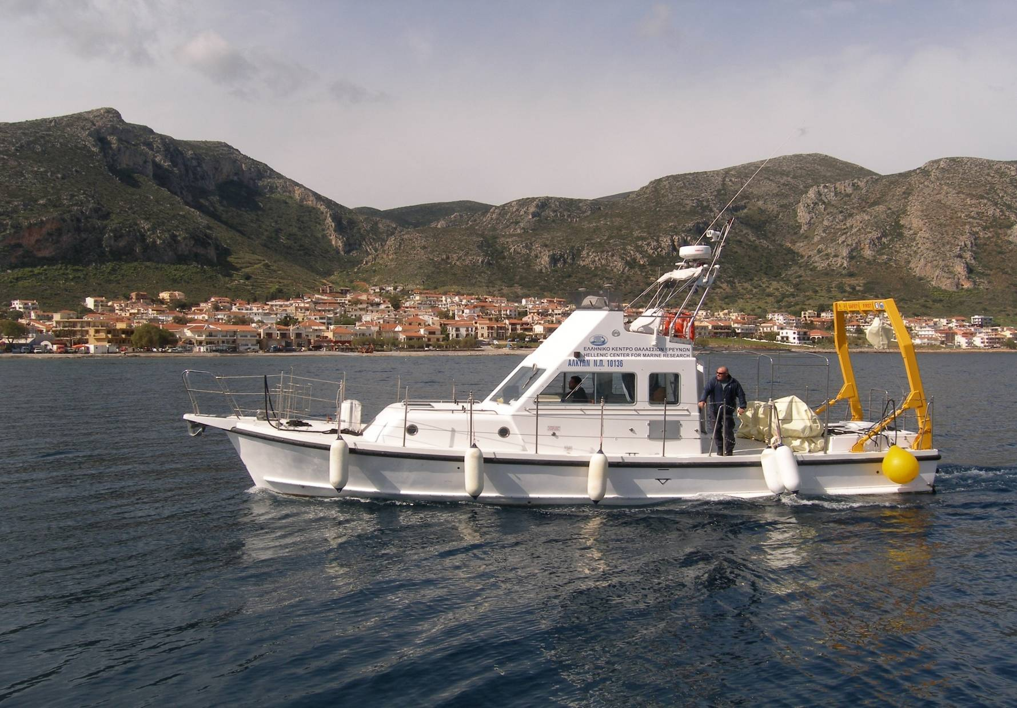
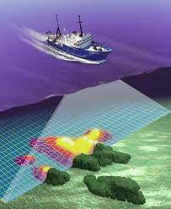
AKTI: Marine research infrastructure
S/V Alcyone of HCMR

Slide 11
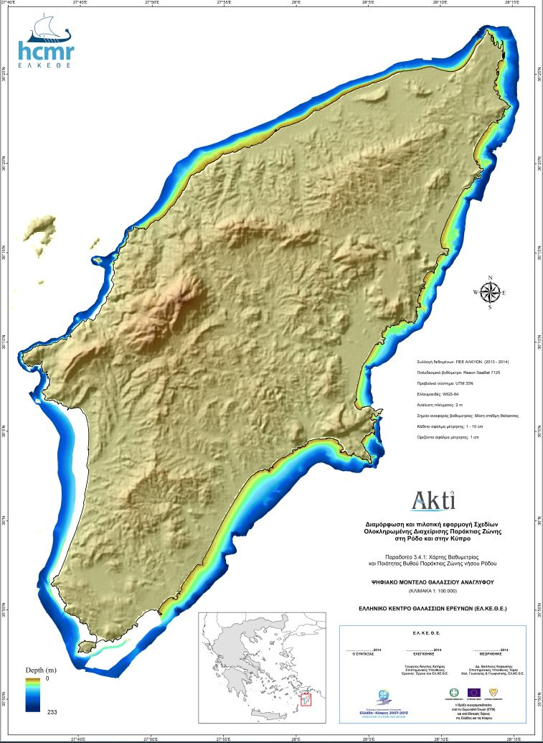
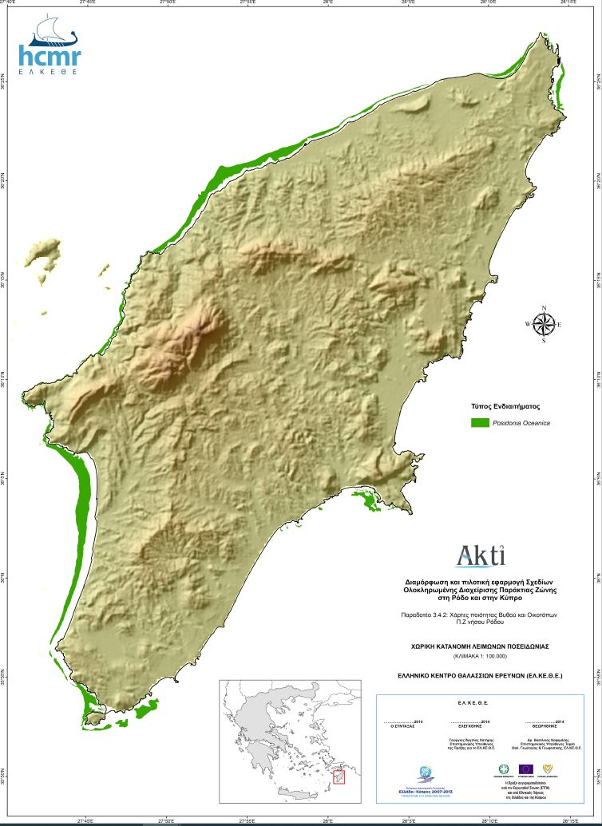
AKTI: bathymetric and benthic habitat maps

Slide 12
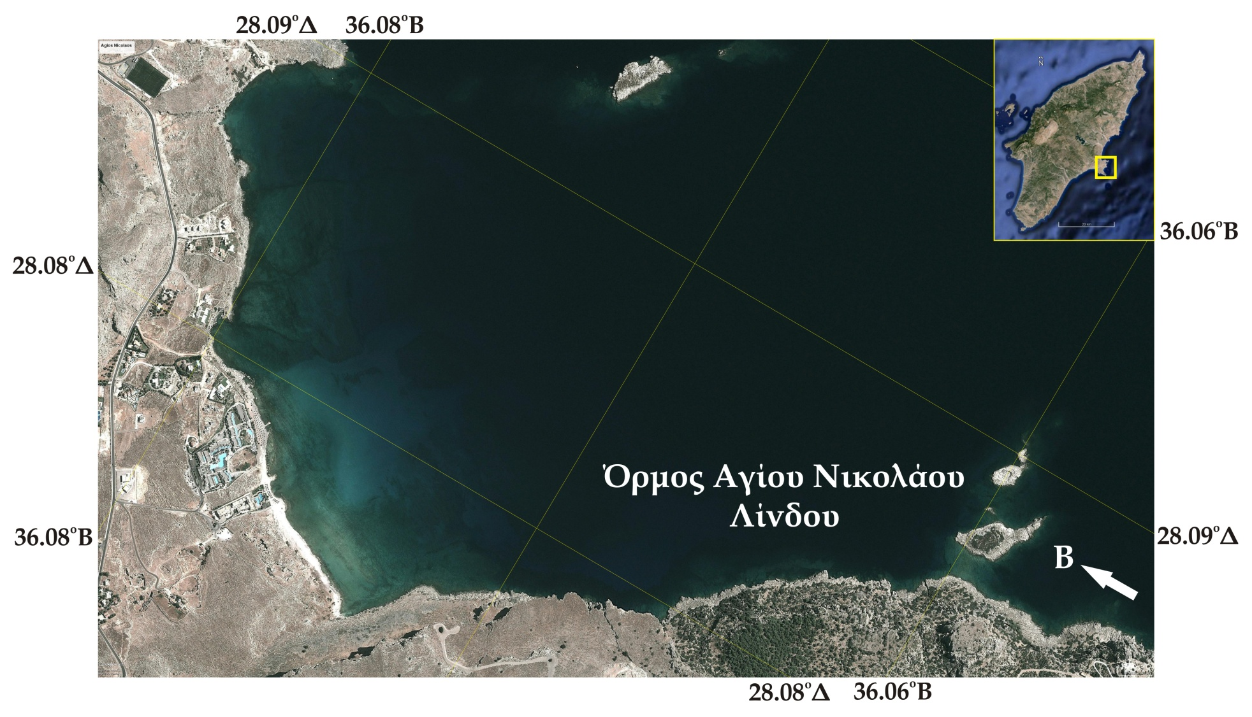
AKTI: Case study for a diving park > Agios Nikolaos Bay, Rhodes

Slide 13
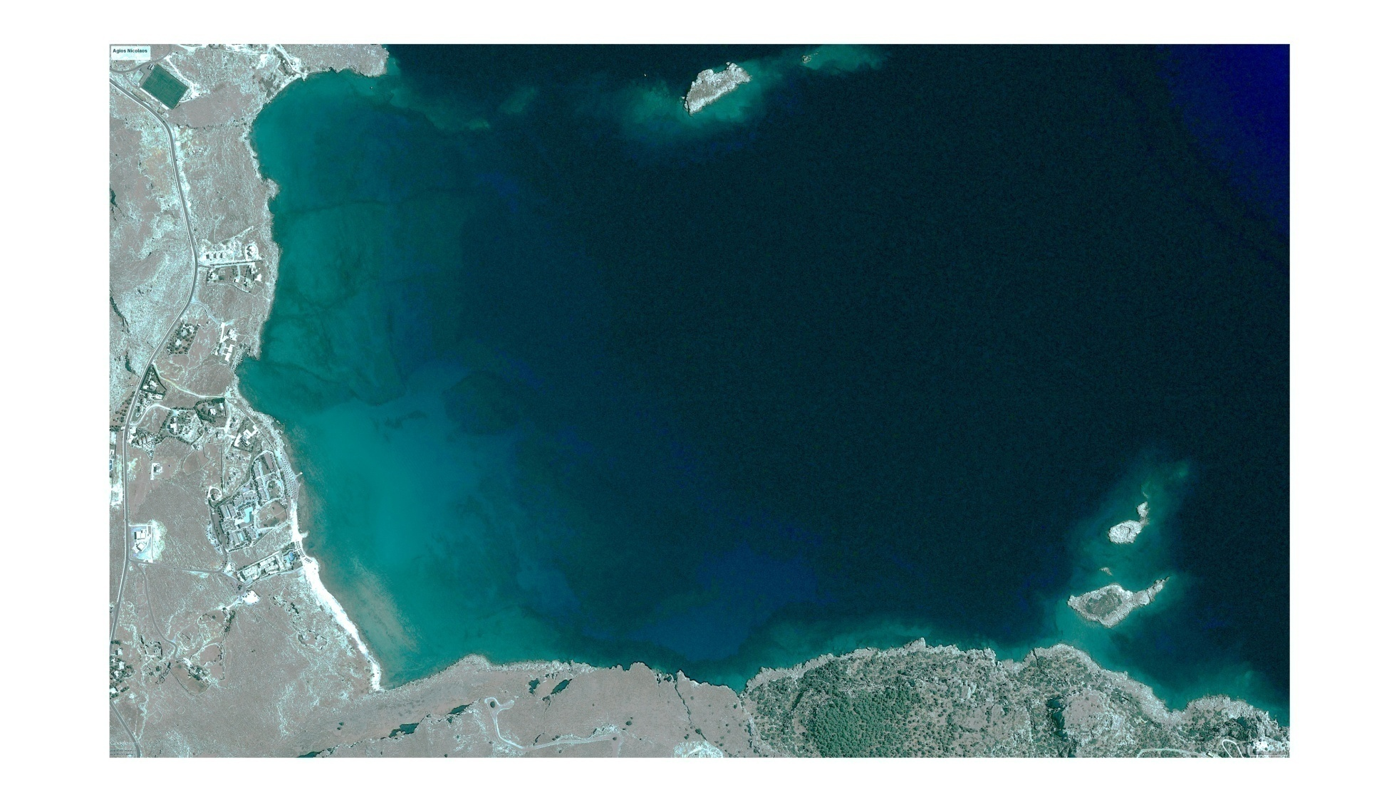
AKTI: Case study for a diving park > Agios Nikolaos Bay, Rhodes > Remote sensing reconnaissance

Slide 14
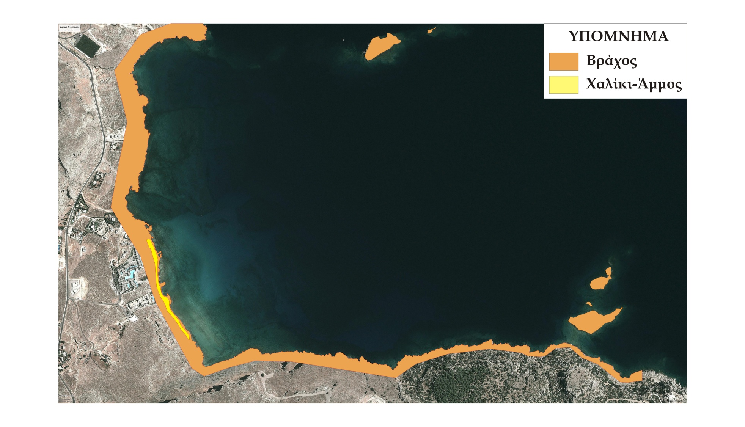
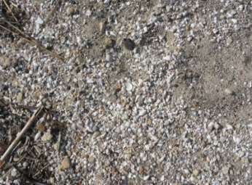
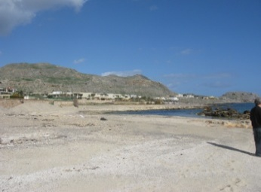
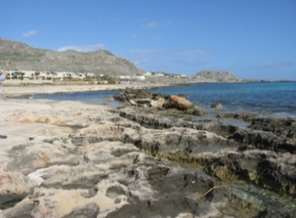
AKTI: Case study for a diving park > Agios Nikolaos Bay, Rhodes > Coastal sediments’ composition and dynamics
Sandy – pebble beach
Rocky shores

Slide 15
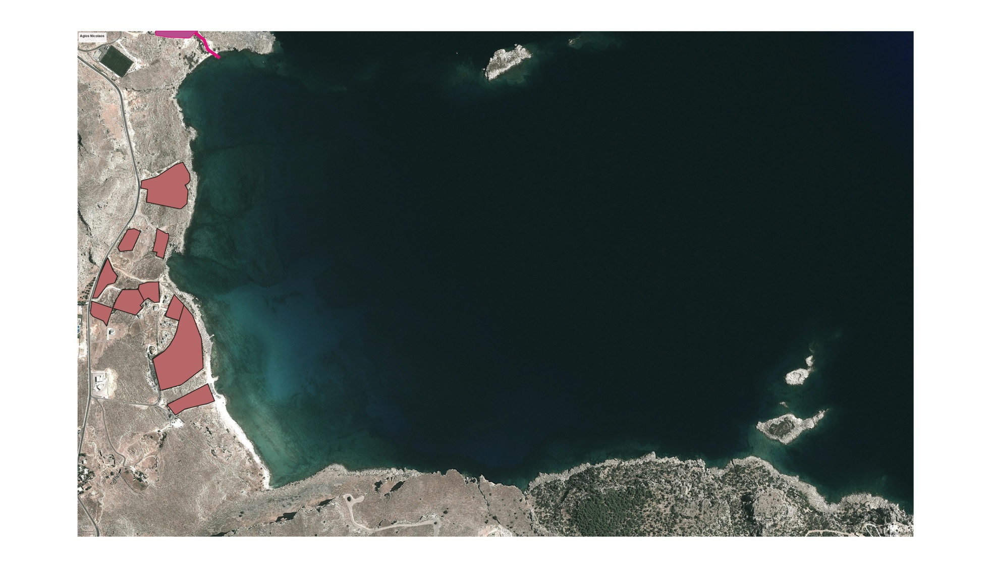
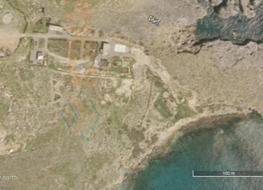
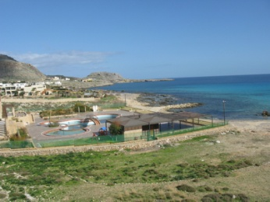
AKTI: Case study for a diving park > Agios Nikolaos Bay, Rhodes > Land use and pollution sources
Waste Water Treatment Plant
Hotels

Slide 16
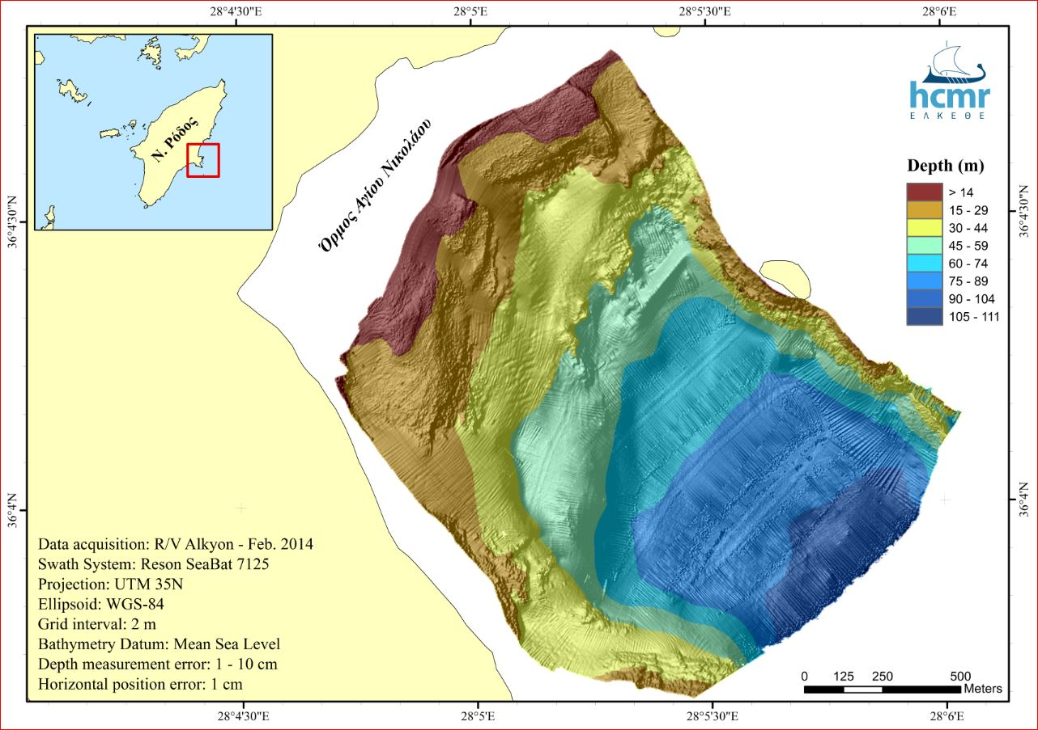
AKTI: Case study for a diving park > Agios Nikolaos Bay, Rhodes > Multi-beam Bathymetry > Bathymetric Maps

Slide 17
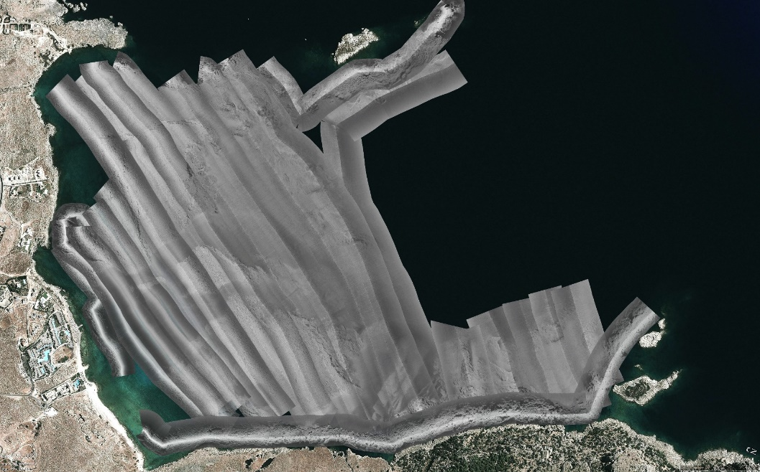
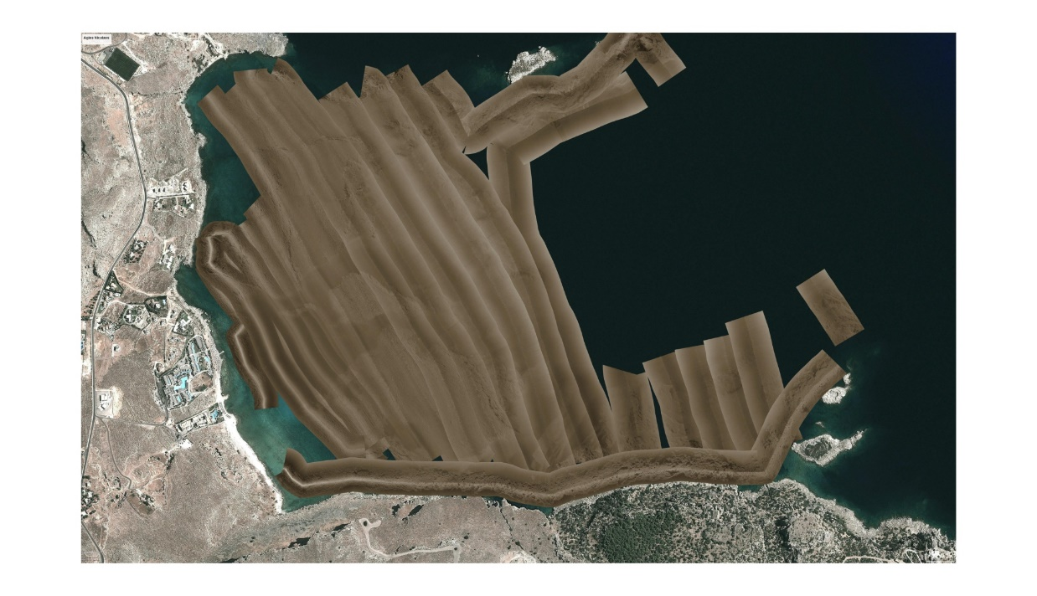

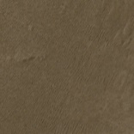
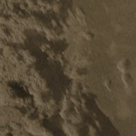
AKTI: Case study for a diving park > Agios Nikolaos Bay, Rhodes > Side-scan sonar survey and sediment sampling
Muddy clay
Sand
Rocks

Slide 18
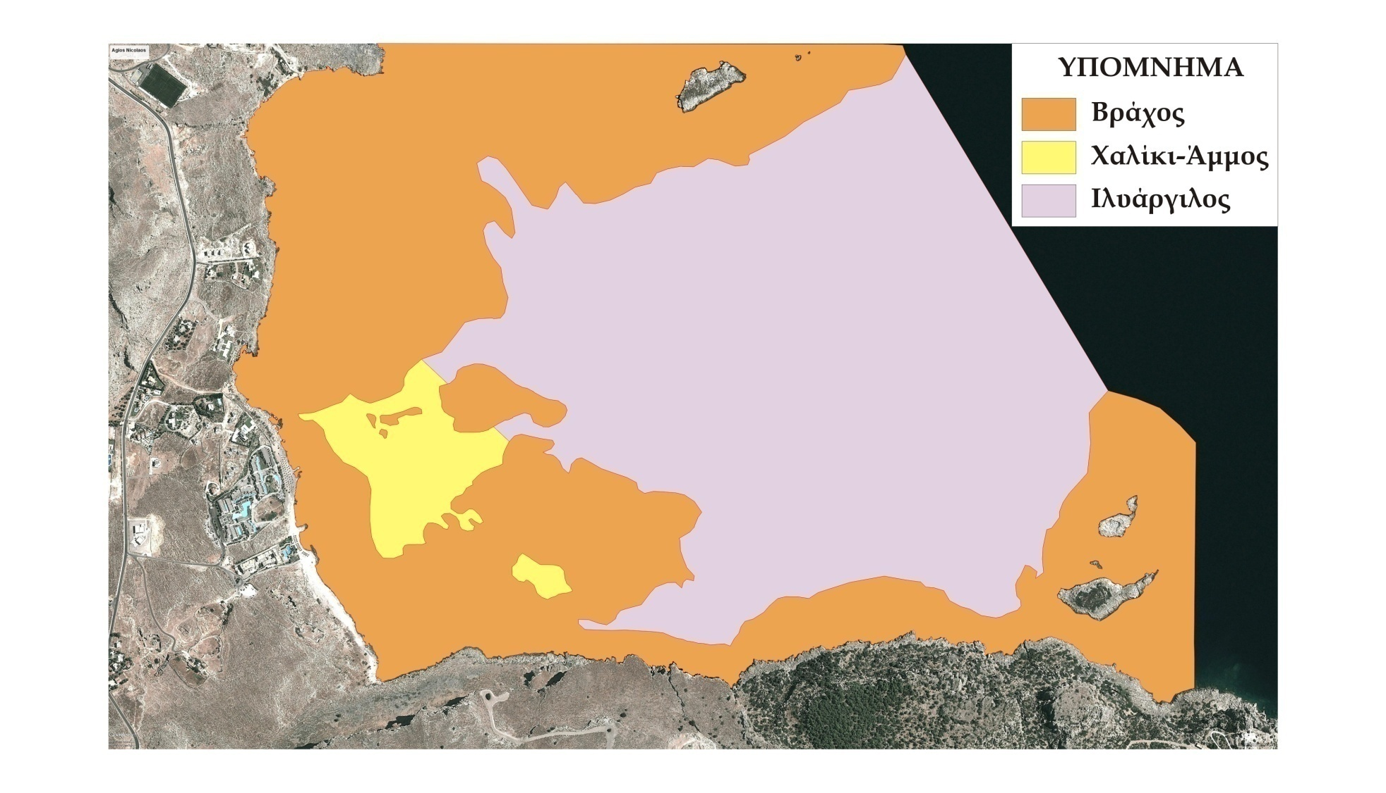
AKTI: Case study for a diving park > Agios Nikolaos Bay, Rhodes > Benthic habitat maps
Legend
Rock
Sand - Pebbles
Muddy Clay

Slide 19
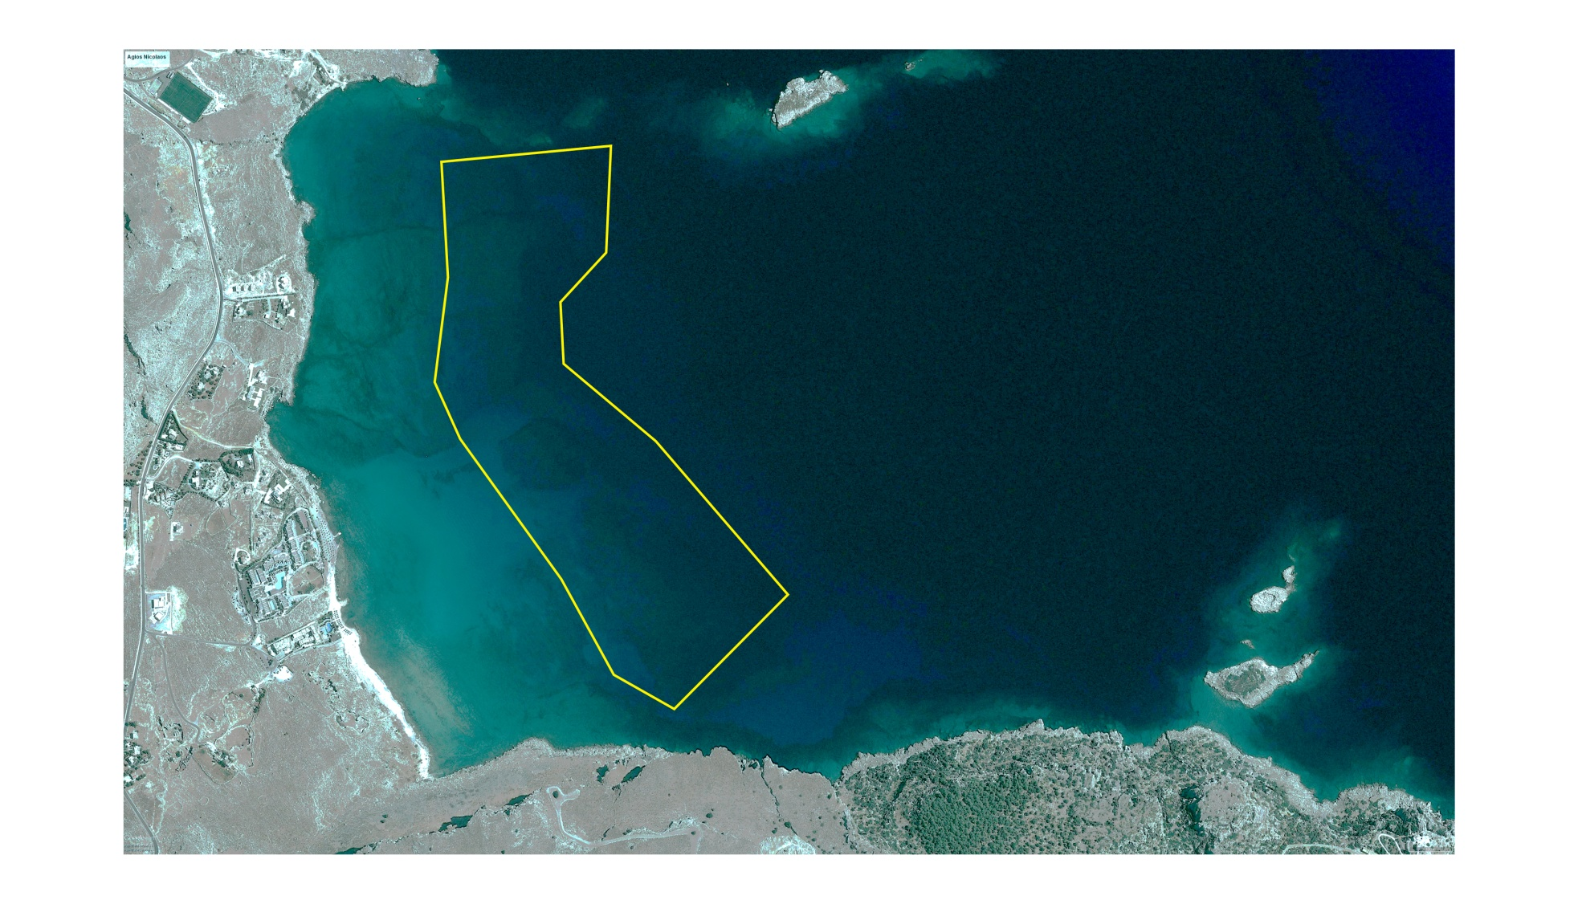
AKTI: Case study for a diving park > Agios Nikolaos Bay, Rhodes > Management proposal
Suitable area for diving activities ?

Slide 20
Thank you for your attention –
Ευχαριστούμε για την προσοχή σας

