Slide 1


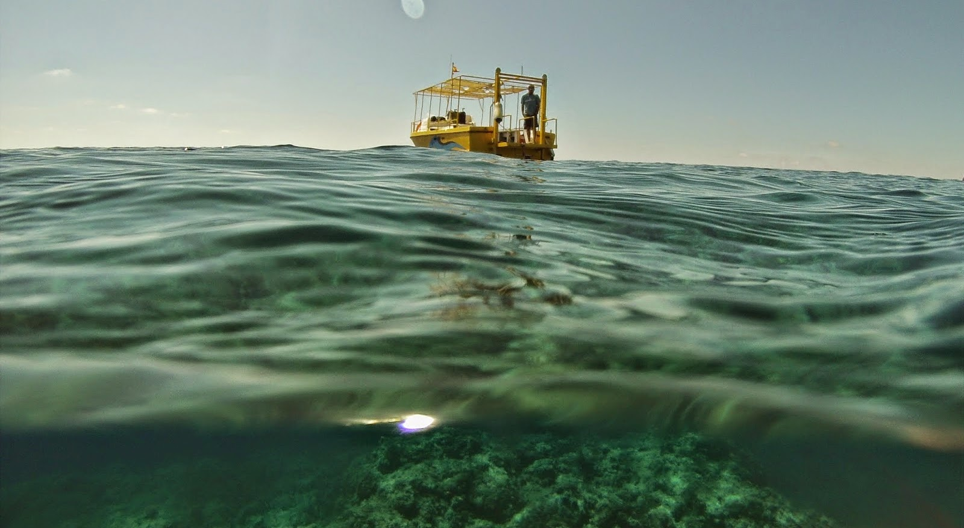
Isla Grosa Project:
underwater archaeological trail as educational and touristic resource involving local diving centers
Workshop on Diving Tourism
ANDIKAT EU project Iat INTERREG GREECE CYPRUS V-A 2014-2020
28 November 2019, Rhodes
Felipe Cerezo Andreo
Universidad de Cádiz
feilpe.Cerezo@uca.es

Slide 2
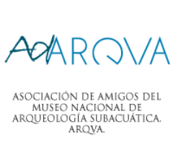
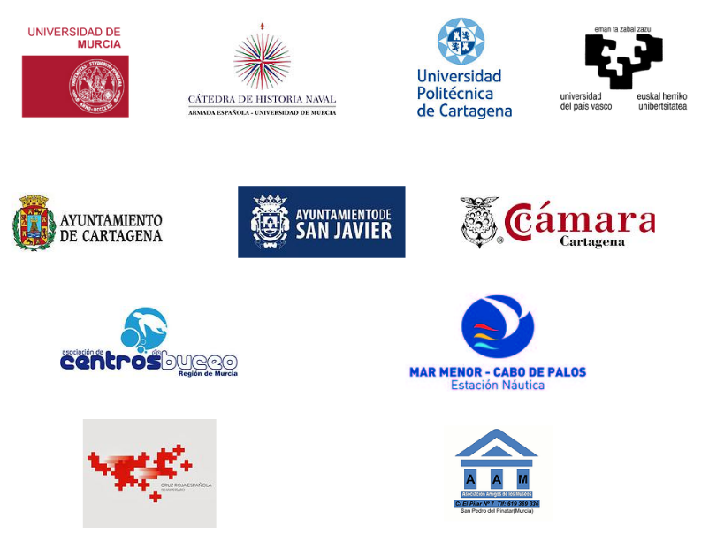



Workshop on Diving Tourism, 28 November 2019, Rhodes.

Slide 3
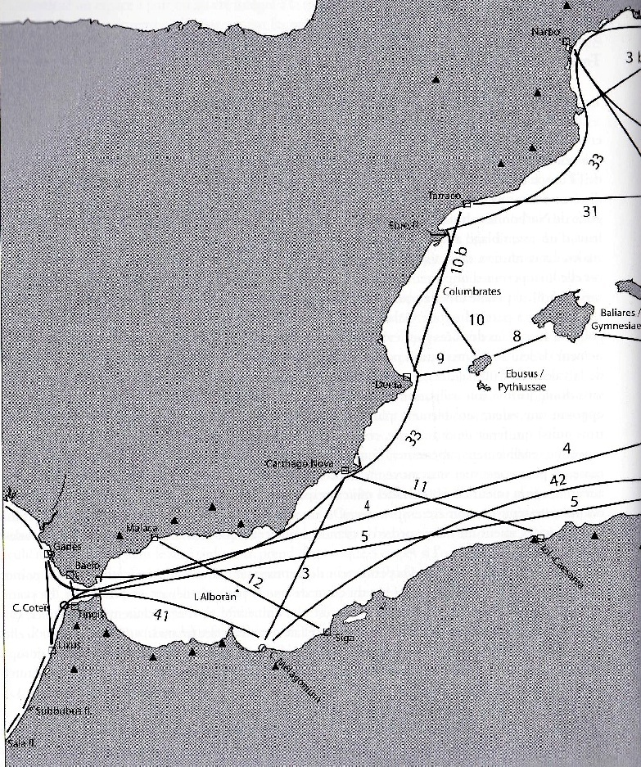
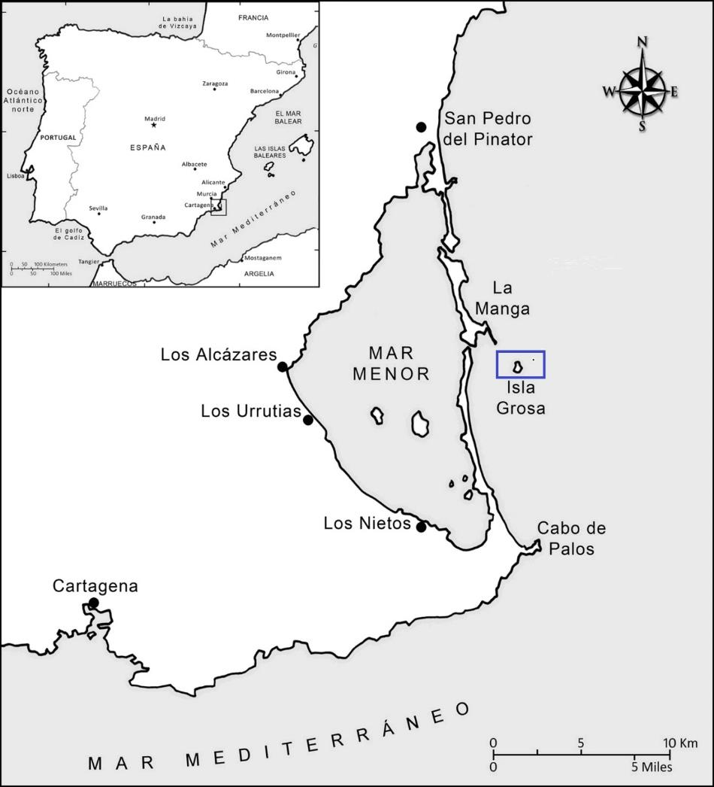
Workshop on Diving Tourism, 28 November 2019, Rhodes.
ARNAUD, PASCAL. “Les routes de la navigation antique” Pág. 154

Slide 4
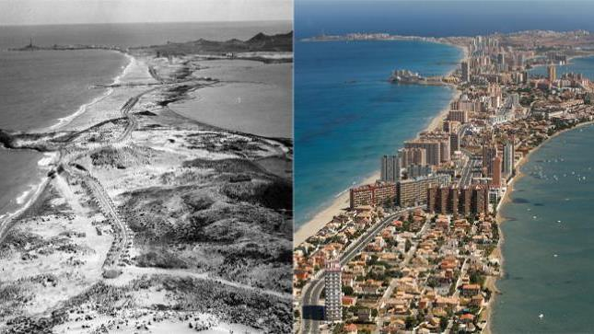
Workshop on Diving Tourism, 28 November 2019, Rhodes.

Slide 5
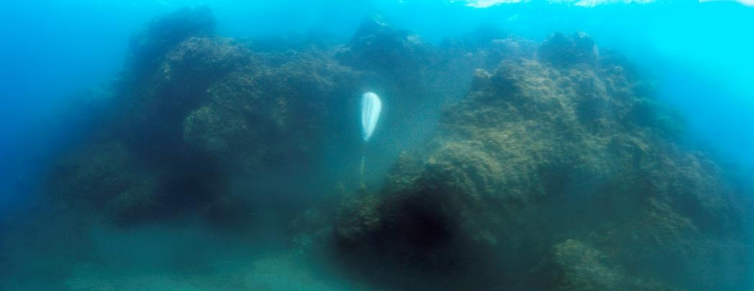
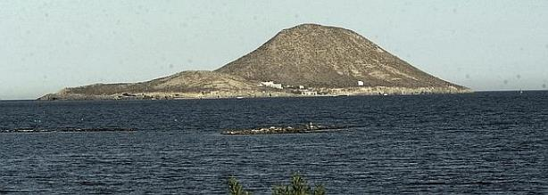
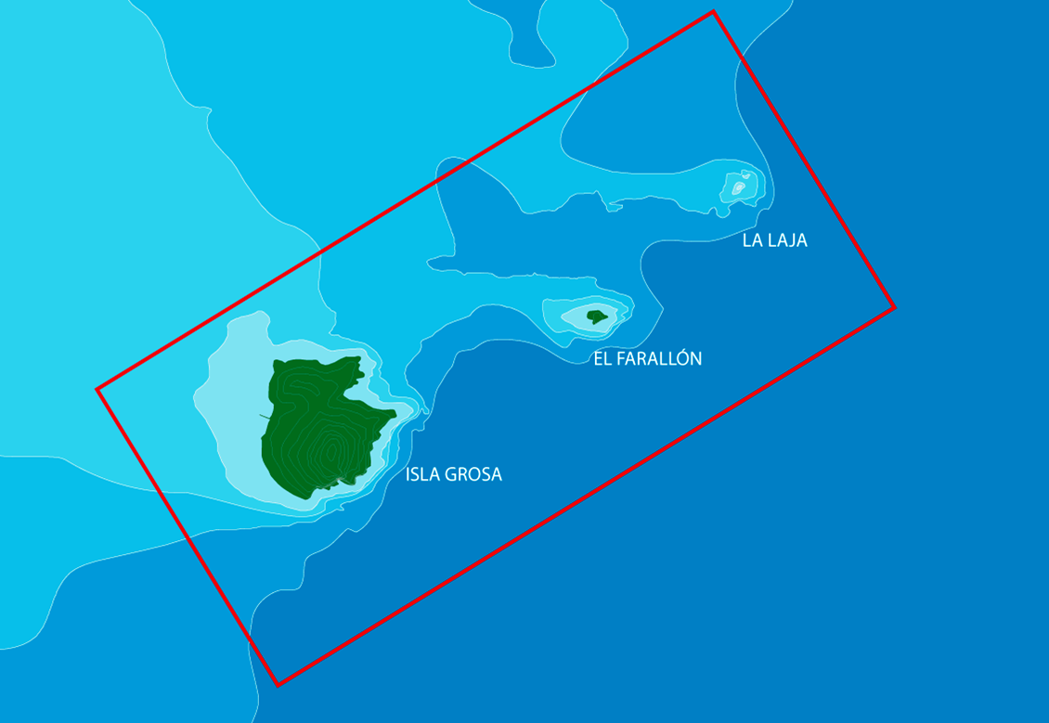
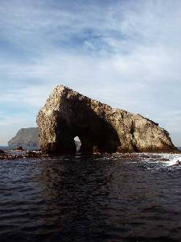
Workshop on Diving Tourism, 28 November 2019, Rhodes.

Slide 6
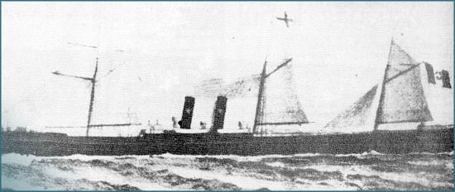
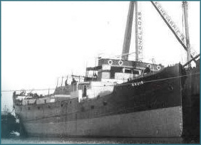
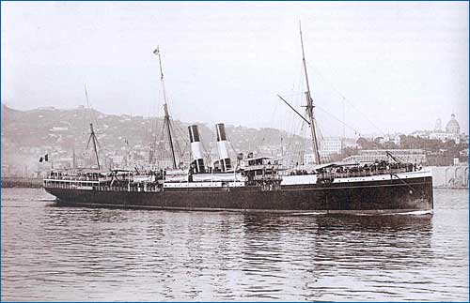
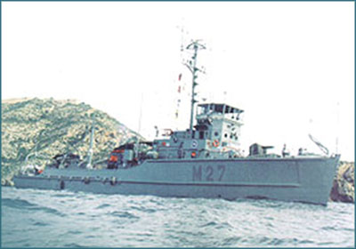
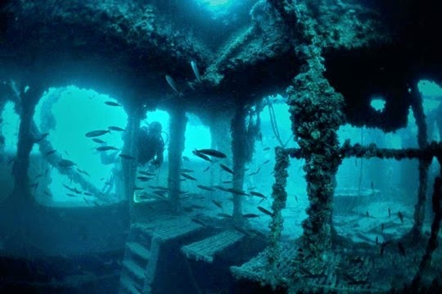
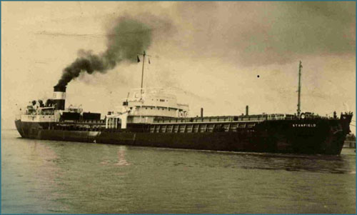
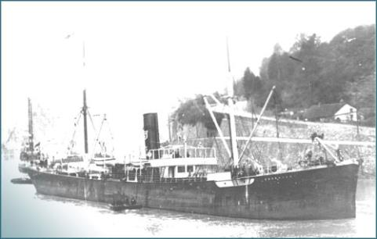
Workshop on Diving Tourism, 28 November 2019, Rhodes.

Slide 7
The Heritage Interpretation as a key of education and raise awareness. An opportunity for a sustainable economy with a cultural base.
Workshop on Diving Tourism, 28 November 2019, Rhodes.
UCH
Research
Knowledge
Comunication
Interpretation
Awareness

Slide 8

Workshop on Diving Tourism, 28 November 2019, Rhodes.
Research
FieldSchool
Underwater trail

Slide 9
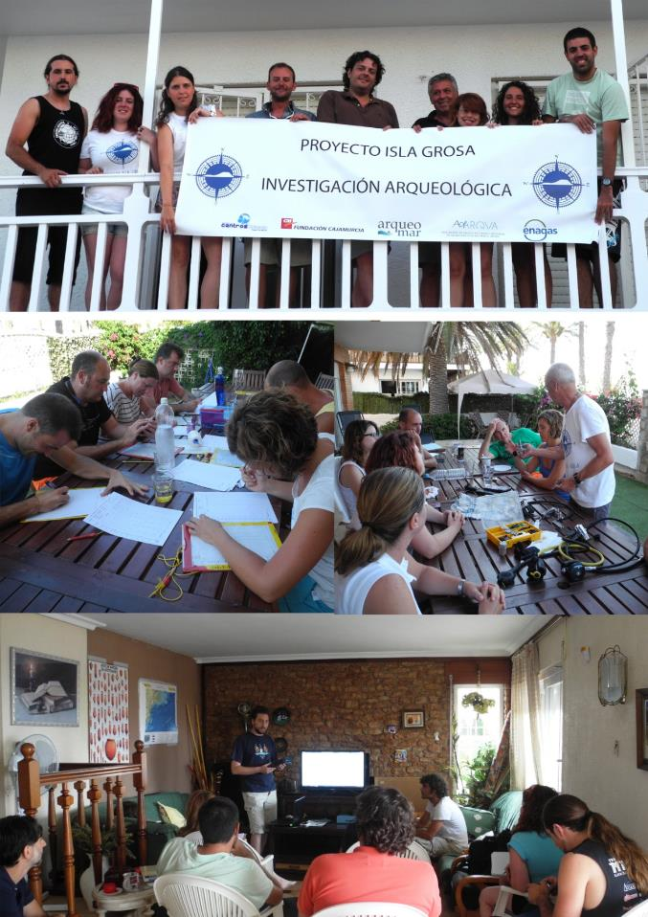
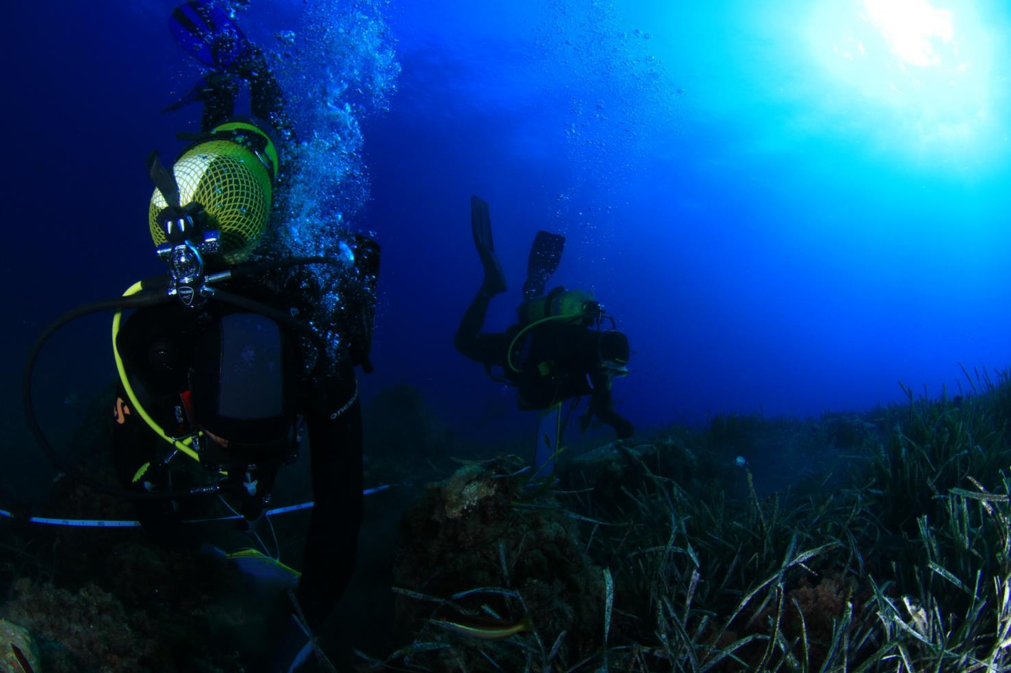
Workshop on Diving Tourism, 28 November 2019, Rhodes.

Slide 10
Workshop on Diving Tourism, 28 November 2019, Rhodes.

Slide 11
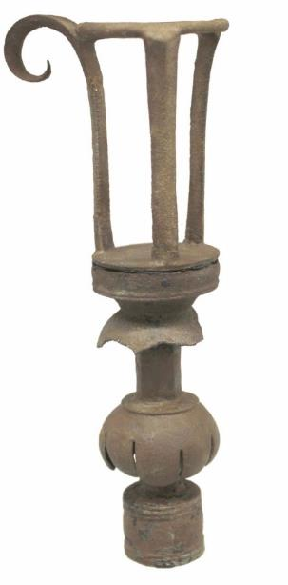
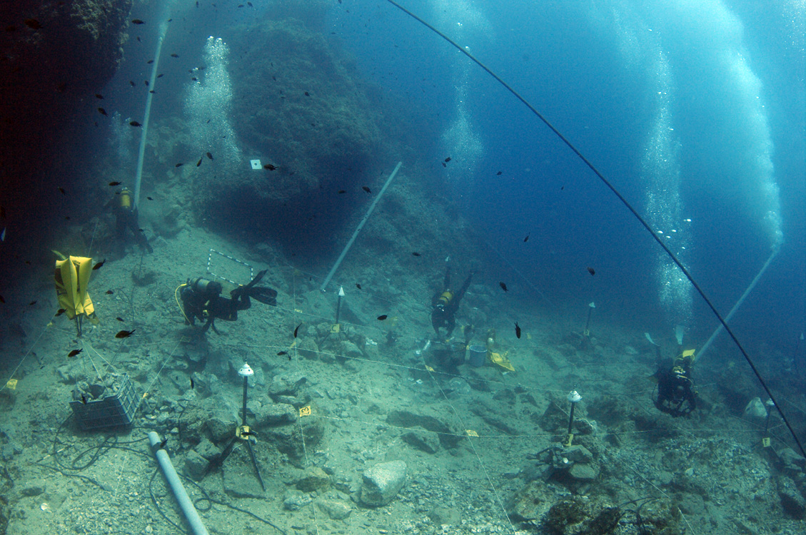
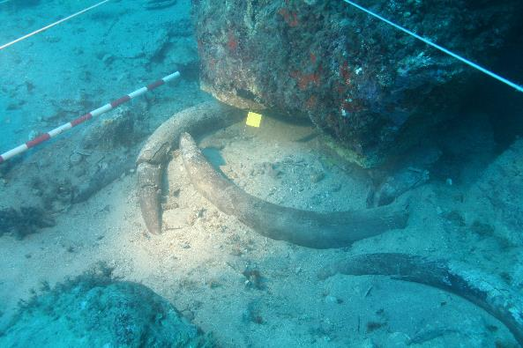
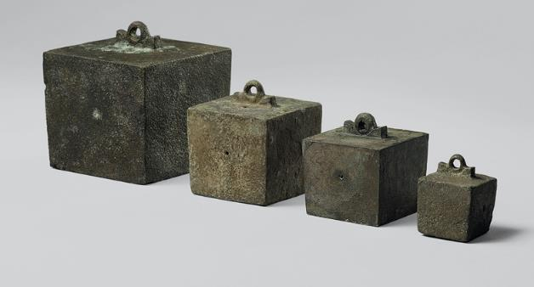
Workshop on Diving Tourism, 28 November 2019, Rhodes.
2007-2011
INA Texas/ ARQUA
Juan Pinedo Reyes
Mark Polzer

Slide 12
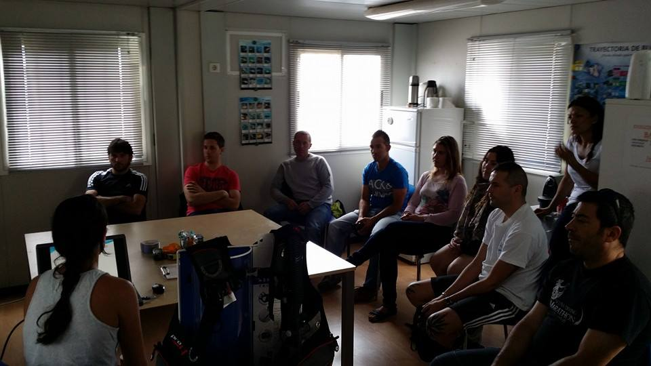
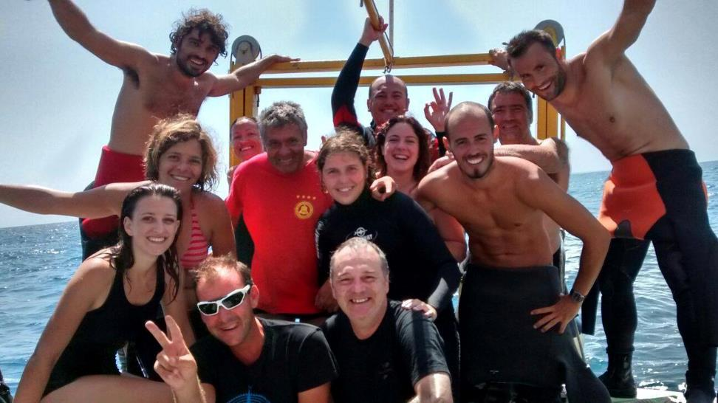
Identify the needs of local dive centers and the public.
Workshop on Diving Tourism, 28 November 2019, Rhodes.

Slide 13
Workshop on Diving Tourism, 28 November 2019, Rhodes.
1. Diver awareness analysis

Slide 14
Workshop on Diving Tourism, 28 November 2019, Rhodes.

Slide 15
Workshop on Diving Tourism, 28 November 2019, Rhodes.

Slide 16
Workshop on Diving Tourism, 28 November 2019, Rhodes.

Slide 17
Workshop on Diving Tourism, 28 November 2019, Rhodes.
How to dive on archaeological remains
UCH knowledge
Interest
How to report a finding
Has dived on a shipwreck
Has dived on a UCH site

Slide 18
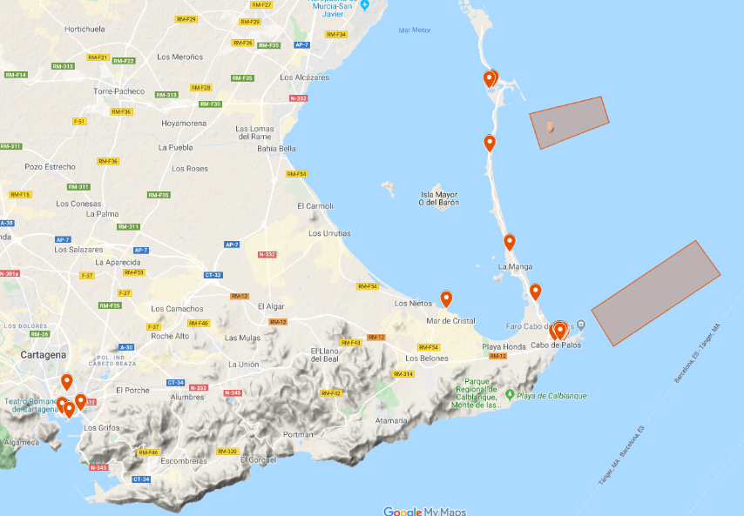


Workshop on Diving Tourism, 28 November 2019, Rhodes.

Slide 19

Workshop on Diving Tourism, 28 November 2019, Rhodes.
Visitors
Dive Centres
Max 2 groups per day
8 divers each group
UCH Awareness
Cultural Information
Provide
Archaeological and heritage
authorization

Slide 20

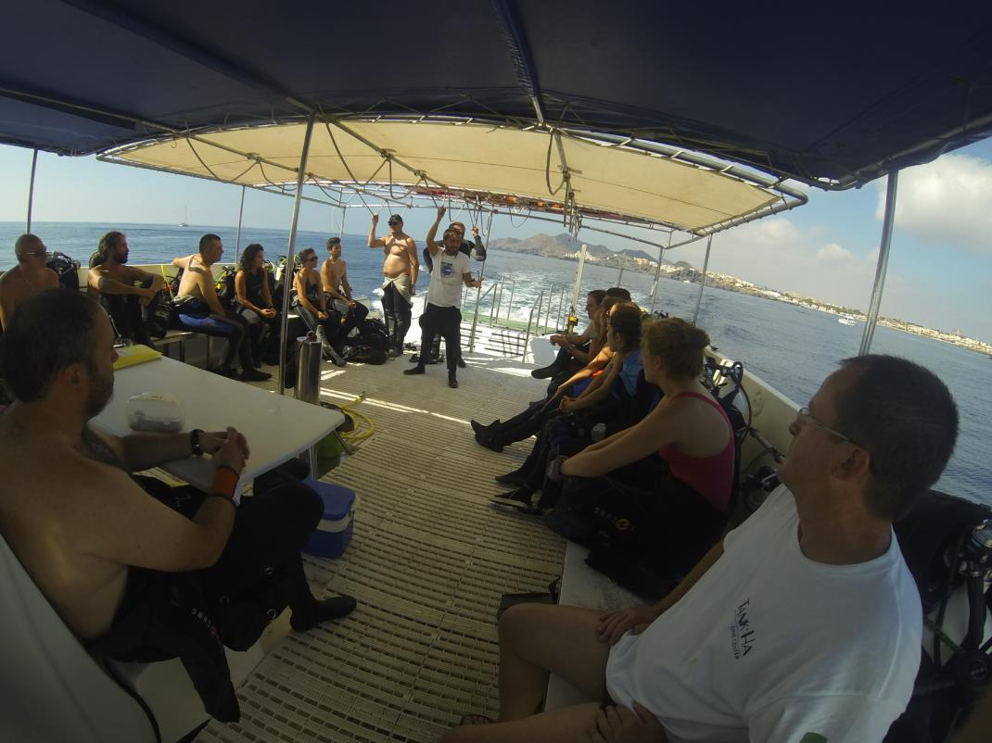
Workshop on Diving Tourism, 28 November 2019, Rhodes.

Slide 21
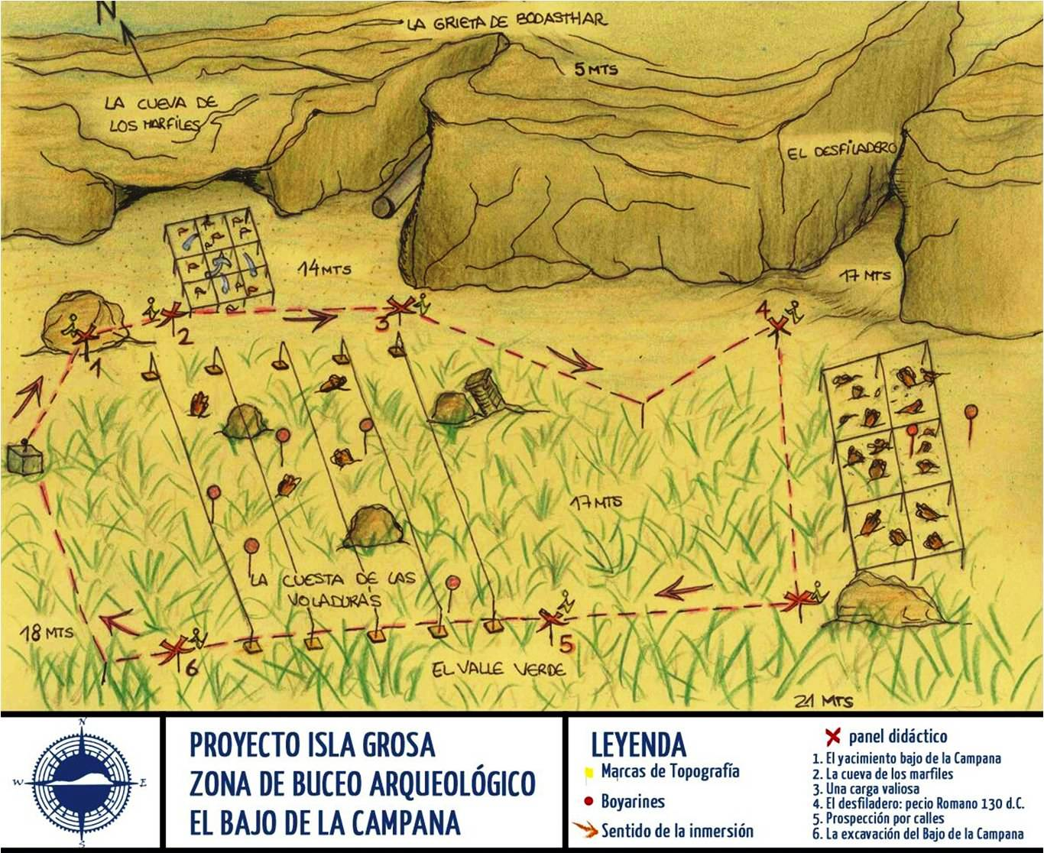

Slide 22
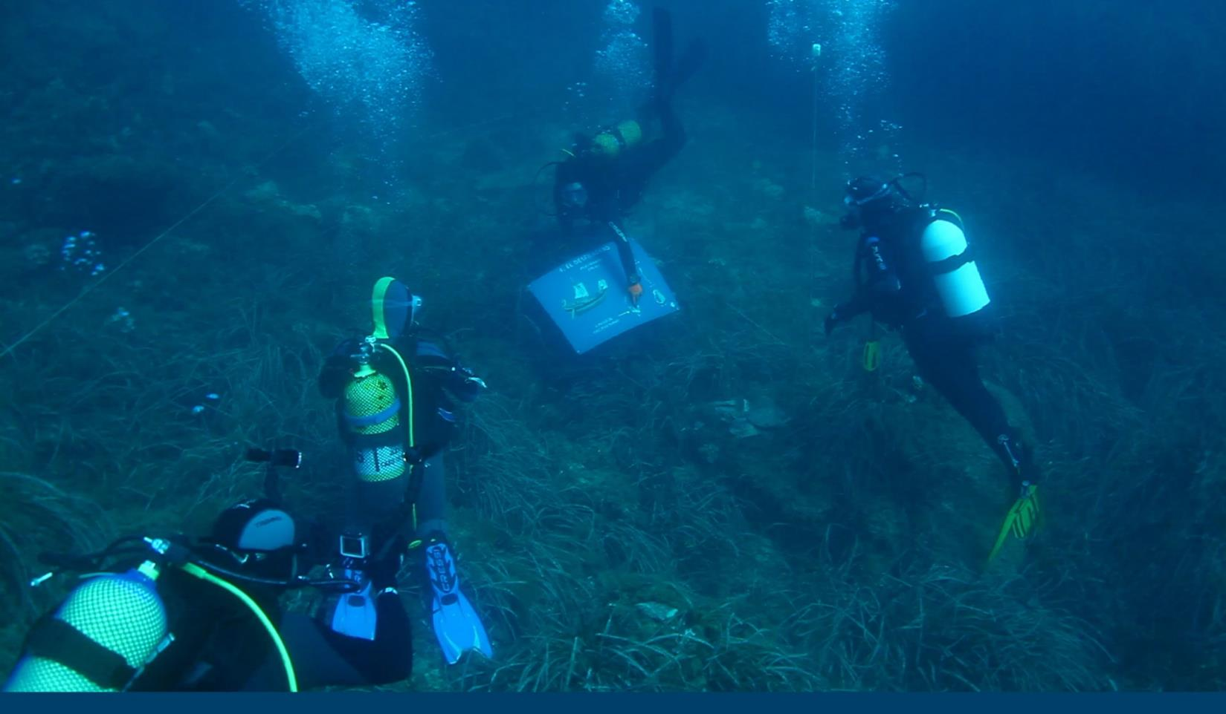
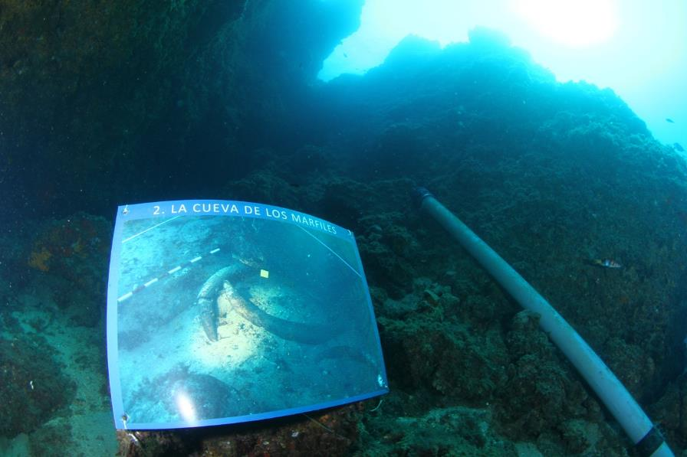
Workshop on Diving Tourism, 28 November 2019, Rhodes.

Slide 23
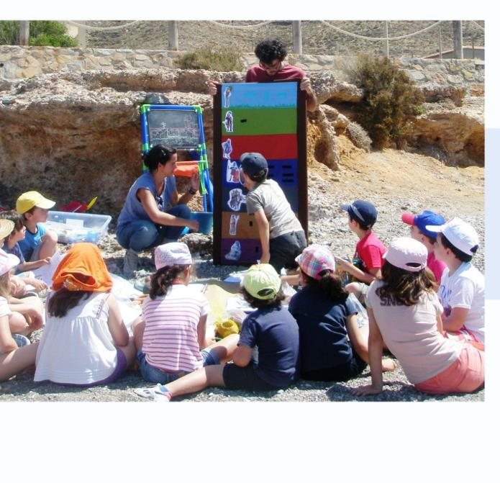
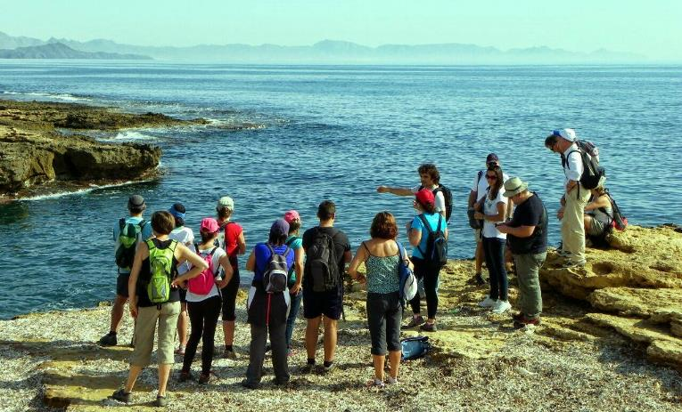
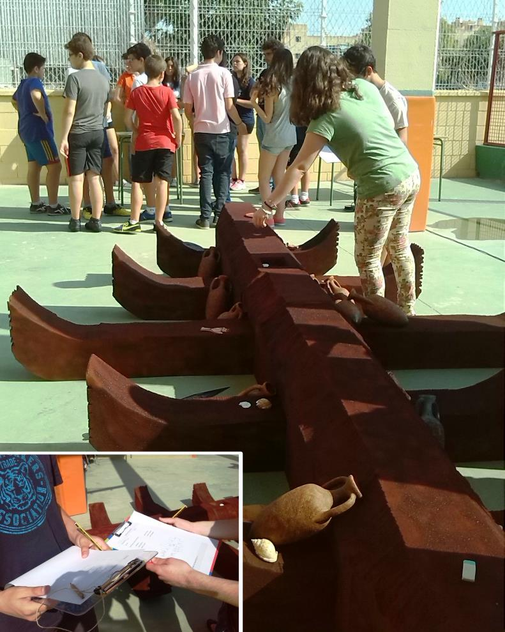
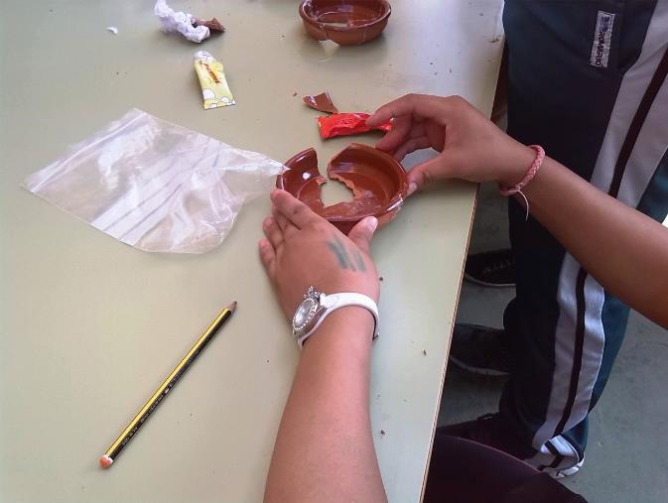
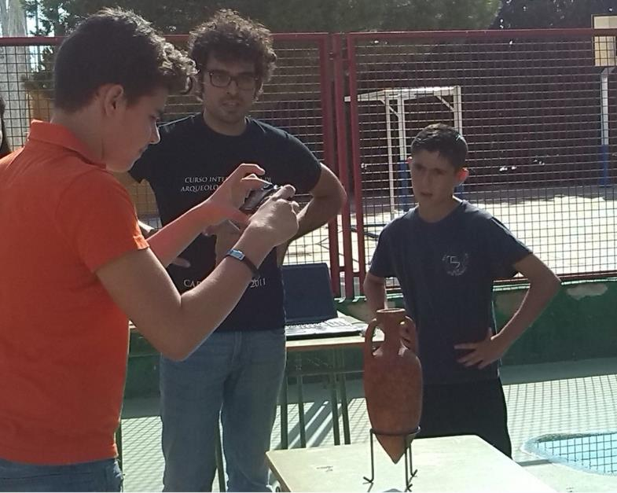
Workshop on Diving Tourism, 28 November 2019, Rhodes.

Slide 24
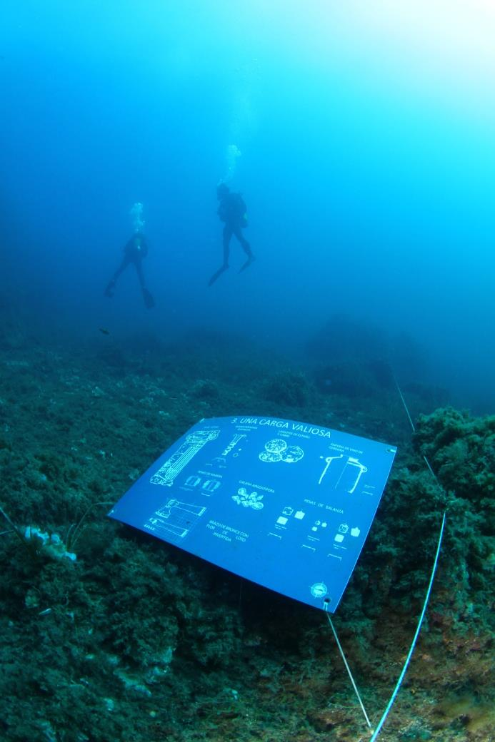
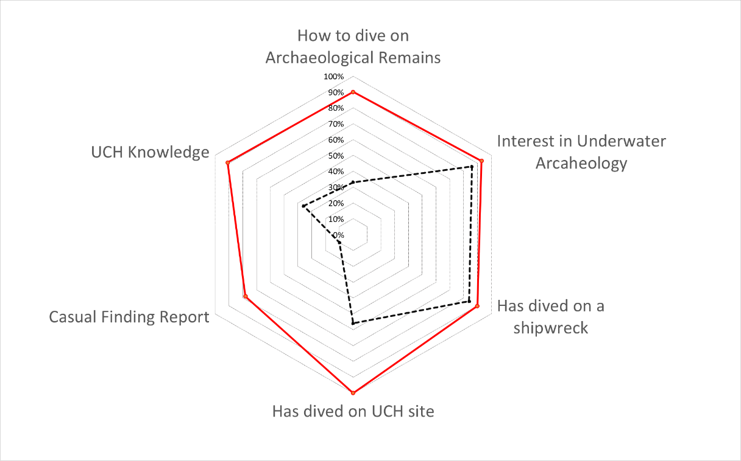
Workshop on Diving Tourism, 28 November 2019, Rhodes.

Slide 25
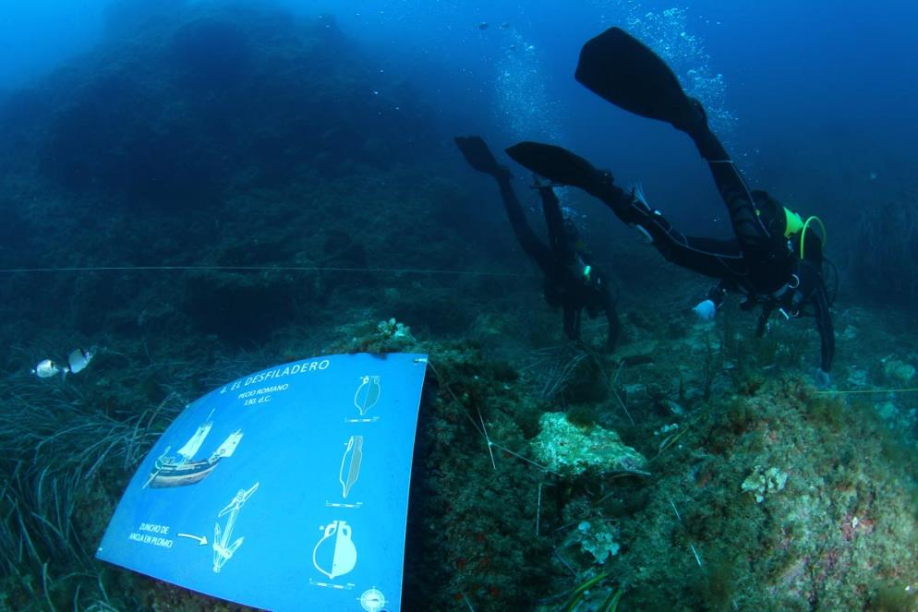
Some Questions…
Workshop on Diving Tourism, 28 November 2019, Rhodes.
How?
Who does it?
Why?
It is necessary?
Who manages it?
Who controls it?
Who can access?
Fragile tourist resource, then, how many and who can visit it?
…

Slide 26
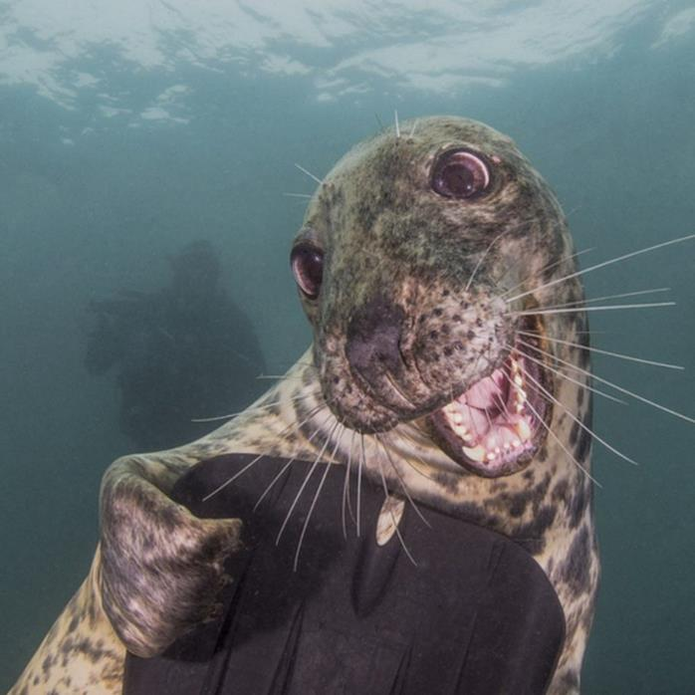

Workshop on Diving Tourism, 28 November 2019, Rhodes.
Carlota Pérez-Reverte: carlotapreverte@gmail.com
Felipe Cerezo Andreo:
felipe.cerezo@uca.es
International Conference in Management of Accessible Underwater Cultural and Natural Heritage Sites:
“Dive in Blue Growth”
16-18 October 2019, Athens

